Slide 1


http://www.comp.nus.edu.sg/~cs2100/
Recitation 9
Combinational Circuits,
MSI Circuits

Slide 2
Agenda
Quick Summary
Solutions to Rec9 Quizzes
Sli.Do Questions

Slide 3
summary
Design Methods

Slide 4
5. Block-Level Design
More complex circuits can also be built using block-level method.
In general, block-level design method (as opposed to gate-level design) relies on algorithms or formulae of the circuit, which are obtained by decomposing the main problem to sub-problems recursively (until small enough to be directly solved by blocks of circuits).
First example shows how to create a 4-bit parallel adder using block-level design.
Using 4-bit parallel adders as building blocks, we can create the following:
1. BCD-to-Excess-3 Code Converter
2. 16-bit Parallel Adder

Slide 5
5. 4-bit Parallel Adder (1/4)
Consider a circuit to add two 4-bit numbers together and a carry-in, to produce a 5-bit result.
X₄
X₃
X₂
X₁
Y₄
Y₃
Y₂
Y₁
4-bit
Parallel Adder
C₅
C₁
Black-box view of 4-bit parallel adder
S₄
S₃
S₂
S₁
5-bit result is sufficient because the largest result is: 1111₂ + 1111₂ + 1₂ = 11111₂

Slide 6
5. 4-bit Parallel Adder (2/4)
SSI design (gate-level design) technique should not be used here.
Truth table for 9 inputs is too big: 2⁹ = 512 rows!
X₄X₃X₂X₁ | Y₄Y₃Y₂Y₁ | C₁ | C₅ | S₄S₃S₂S₁
0 0 0 0 | 0 0 0 0 | 0 | 0 | 0 0 0 0
0 0 0 0 | 0 0 0 0 | 1 | 0 | 0 0 0 1
0 0 0 0 | 0 0 0 1 | 0 | 0 | 0 0 0 1
… | … | … | … | …
0 1 0 1 | 1 1 0 1 | 1 | 1 | 0 0 1 1
… | … | … | … | …
1 1 1 1 | 1 1 1 1 | 1 | 1 | 1 1 1 1
Simplification becomes too complicated!

Slide 7
5. 4-bit Parallel Adder (3/4)
Alternative design possible.
Addition formula for each pair of bits (with carry in), C_{i+1}S_{i} = X_{i} + Y_{i} + C_{i} has the same function as a full adder: C_{i+1} = X_{i} ⋅Y_{i} + (X_{i} ⊕Y_{i})⋅C_{i} S_{i} = X_{i} ⊕ Y_{i} ⊕ C_{i}
C =
X = 1 0 1 0
Y = 1 1 1 1
X + Y =
1
1
0
0
1
1
0
0
1

Slide 8
5. 4-bit Parallel Adder (4/4)
Cascading 4 full adders via their carries, we get:
Y₄ X₄
Y₃ X₃
Y₂ X₂
Y₁ X₁
C₄
C₃
C₂
C₅
FA
FA
FA
FA
C₁
Input
Output
S₄
S₃
S₂
S₁
Note that carry is propagated by cascading the carry from one full adder to the next.
Called Parallel Adder because inputs are presented simultaneously (in parallel). Also called Ripple-Carry Adder.

Slide 9
5. 16-bit Parallel Adder
Larger parallel adders can be built from smaller ones.
Example: A 16-bit parallel adder can be constructed from four 4-bit parallel adders:
X₁₆..X₁₃
Y₁₆..Y₁₃
X₁₂..X₉
Y₁₂..Y₉
X₈..X₅
Y₈..Y₅
X₄..X₁
Y₄..Y₁
4
4
4
4
4
4
4
4
C₁₇
4-bit // adder
C₁₃
4-bit // adder
C₉
4-bit // adder
C₅
4-bit // adder
C₁
4
4
4
4
S₁₆..S₁₃
S₁₂..S₉
S₈..S₅
S₄..S₁
A 16-bit parallel adder
4
=
S₄..S₁
S₄S₃S₂S₁

Slide 10
summary
MSI Design - Decoders

Slide 11
2. Decoders (4/5)
Design a 3×8 decoder.
F₀ = x'⋅y'⋅z'
x | y | z | F₀ | F₁ | F₂ | F₃ | F₄ | F₅ | F₆ | F₇
0 | 0 | 0 | 1 | 0 | 0 | 0 | 0 | 0 | 0 | 0
0 | 0 | 1 | 0 | 1 | 0 | 0 | 0 | 0 | 0 | 0
0 | 1 | 0 | 0 | 0 | 1 | 0 | 0 | 0 | 0 | 0
0 | 1 | 1 | 0 | 0 | 0 | 1 | 0 | 0 | 0 | 0
1 | 0 | 0 | 0 | 0 | 0 | 0 | 1 | 0 | 0 | 0
1 | 0 | 1 | 0 | 0 | 0 | 0 | 0 | 1 | 0 | 0
1 | 1 | 0 | 0 | 0 | 0 | 0 | 0 | 0 | 1 | 0
1 | 1 | 1 | 0 | 0 | 0 | 0 | 0 | 0 | 0 | 1
F₁ = x'⋅y'⋅z
F₂ = x'⋅y⋅z'
F₃ = x'⋅y⋅z
F₄ = x⋅y'⋅z'
F₅ = x⋅y'⋅z
F₆ = x⋅y⋅z'
F₇ = x⋅y⋅z
x
y
z

Slide 12
2. Decoders: Implementing Functions (3/3)
S(x, y, z) = Σ m(1,2,4,7)
C(x, y, z) = Σ m(3,5,6,7)
3x8
DEC
1
0
0
0
0
0
0
0
0
1
0
0
0
0
0
0
0
1
2
3
4
5
6
7
0
0
0
0
0
0
0
1
0
1
S
1
0
0
1
x
0
0
0
1
1
1
S₂
S₁
S₀
y
0
0
C
1
z
BRAVO!!!


Slide 13
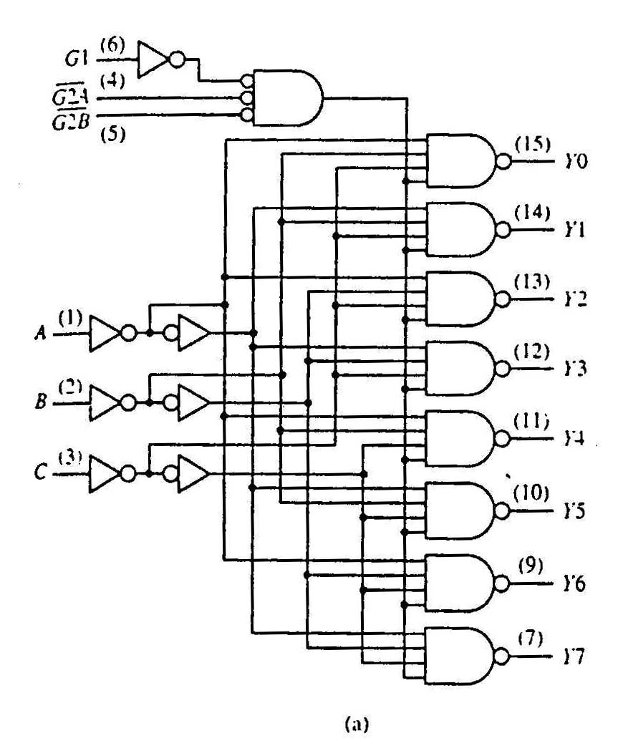
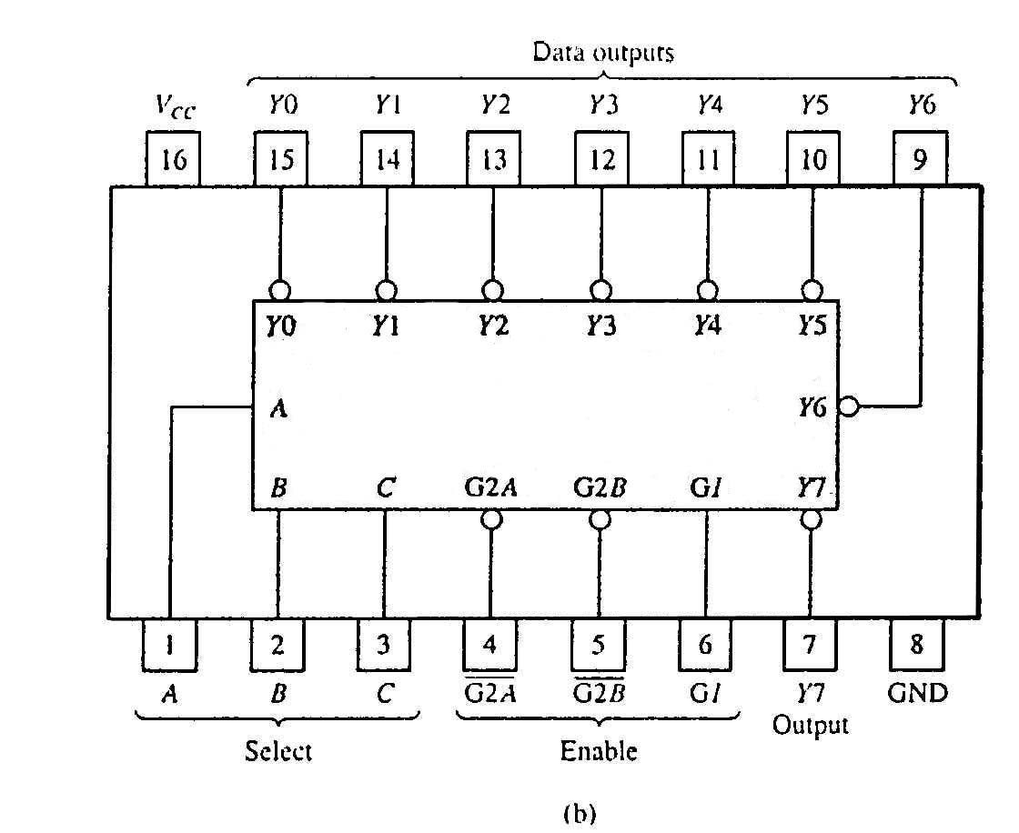
2. Standard MSI Decoder (1/2)
74138 (3-to-8 decoder)
74138 decoder module.
(a) Logic circuit.
(b) Package pin configuration.

Slide 14
2. Decoders: Implementing Functions Revisit (2/2)
f(Q,X,P) = Σm(0,1,4,6,7) = ∏ M(2,3,5)
0
1
2
3
4
5
6
7
0
1
2
3
4
5
6
7
3x8
Dec
3x8
Dec
Q
X
P
A
B
C
f(Q,X,P)
Q
X
P
A
B
C
f(Q,X,P)
(m0'·m1'·m4'·m6'·m7)'
=m0+m1+m4+m6+m7
(a) Active-high decoder with OR gate.
(b) Active-low decoder with NAND gate.
0
1
2
3
4
5
6
7
0
1
2
3
4
5
6
7
3x8
Dec
3x8
Dec
f(Q,X,P)
f(Q,X,P)
Q
X
P
A
B
C
Q
X
P
A
B
C
(m2+m3+m5)'
= m2'·m3'·m5'
= M2·M3·M5
m2'·m3'·m5'
= M2·M3·M5
(c) Active-high decoder with NOR gate.
(d) Active-low decoder with AND gate.

Slide 15
summary
MSI Design - Multiplexers

Slide 16
5. Multiplexers (1/4)
A multiplexer is a device that has
A number of input lines
A number of selection lines
One output line
It steers one of 2^{n} inputs to a single output line, using n selection lines. Also known as a data selector.
2^{n}:1
Multiplexer
inputs
output
:
...
select

Slide 17
5. Multiplexers (2/4)
Truth table for a 4-to-1 multiplexer:
Inputs
Inputs
I₀
0
1
2
3
I₀
I₁
4:1
MUX
I₁
4:1mux
I₂
Y
I₂
Y
Output
I₃
I₃
S₁ S₀
S₁ S₀
select
select

Slide 18
5. Multiplexers: Implementing Functions (2/3)
F(A,B,C) = Σ m(1,3,5,6)
This method works because:
Output = I₀⋅m₀ + I₁⋅m₁ + I₂⋅m₂ + I₃⋅m₃ + I₄⋅m₄ + I₅⋅m₅ + I₆⋅m₆ + I₇⋅m₇
Supplying ‘1’ to I₁,I₃,I₅,I₆ , and ‘0’ to the rest:
Output = m₁ + m₃ + m₅ + m₆
0
1
0
1
0
1
1
0
0
1
2
3
4
5
6
7
F
mux
A B C
From slide 34 (4:1 mux)
Expressing
I₀∙(S₁'∙S₀') + I₁∙(S₁'∙S₀) + I₂∙(S₁∙S₀') + I₃∙(S₁∙S₀)
in minterms notation, it is equal to
I₀∙m₀ + I₁∙m₁ + I₂∙m₂ + I₃∙m₃

Slide 19
5. Using Smaller Multiplexers (1/6)
Earlier, we saw how a 2^{n}-to-1 multiplexer can be used to implement a Boolean function of n (input) variables.
However, we can use a single smaller 2^{(n-1)}-to-1 multiplexer to implement a Boolean function of n (input) variables.
Example: The function F(A,B,C) = Σ m(1,3,5,6) can be implemented using a 4-to-1 multiplexer (rather than an 8-to-1 multiplexer).

Slide 20
5. Using Smaller Multiplexers (2/6)
Let’s look at this example:
F(A,B,C) = Σ m(0,1,3,6) = A'⋅B'⋅C' + A'⋅B'⋅C + A'⋅B⋅C + A⋅B⋅C'
1
1
0
1
0
0
1
0
0
1
2
3
4
5
6
7
1
C
0
C'
0
1
2
3
F
mux
F
mux
A B C
A B
Note: Two of the variables, A and B, are applied as selection lines of the multiplexer, while the inputs of the multiplexer contain 1, C, 0 and C'.

Slide 21
5. Using Smaller Multiplexers (3/6)
Procedure
1. Express Boolean function in sum-of-minterms form. Example: F(A,B,C) = Σ m(0,1,3,6)
2. Reserve one variable (in our example, we take the least significant one) for input lines of multiplexer, and use the rest for selection lines. Example: C is for input lines; A and B for selection lines.

Slide 22
5. Using Smaller Multiplexers (4/6)
3. Draw the truth table for function, by grouping inputs by selection line values, then determine multiplexer inputs by comparing input line (C) and function (F) for corresponding selection line values.
A | B | C | F | MUX input
0 | 0 | 0 | 1
0 | 0 | 1 | 1
0 | 1 | 0 | 0
0 | 1 | 1 | 1
1 | 0 | 0 | 0
1 | 0 | 1 | 0
1 | 1 | 0 | 1
1 | 1 | 1 | 0
1
C
0
C'
1
0
0
1
2
3
C
F
mux
A B


Slide 23
5. Using Smaller Multiplexers (5/6)
Alternative: What if we use A for input lines, and B, C for selector lines?
A' (when BC = 00)
A' (when BC = 01)
A (when BC = 10)
A
?
?
?
?
0
1
2
3
0
1
2
3
F
A' (when BC = 11)
F
mux
mux
B C
B C


Slide 24
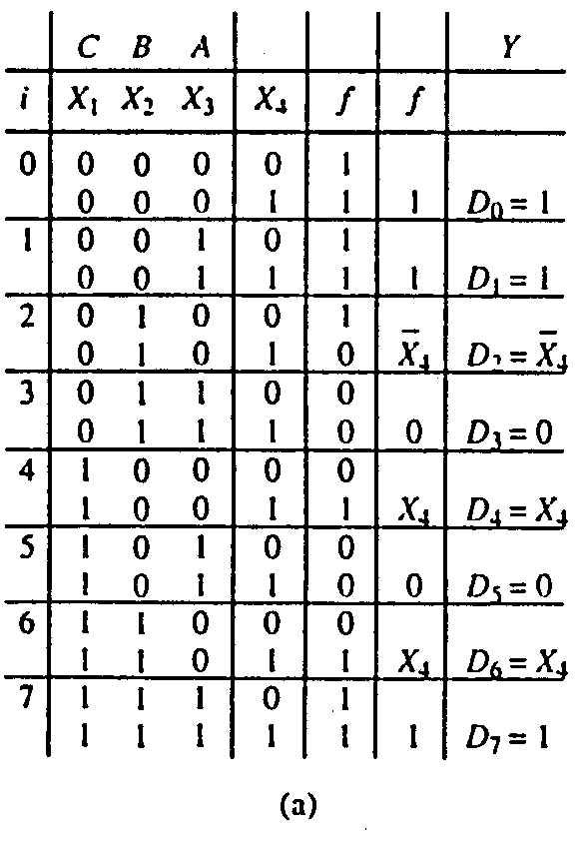
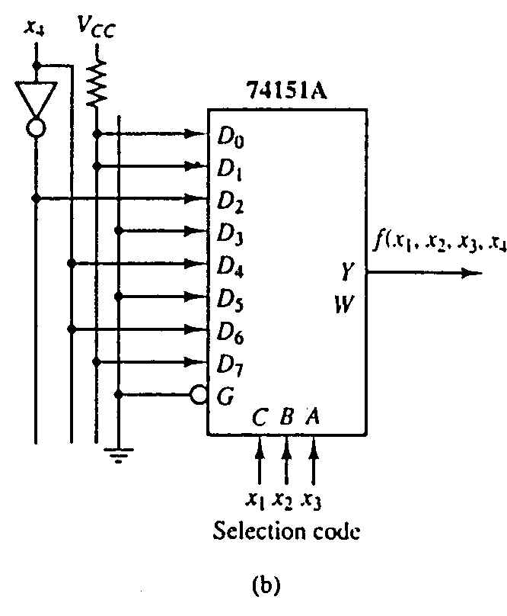
5. Using Smaller Multiplexers (6/6)
Example: Implement the function below with 74151A:
f(x₁,x₂,x₃,x₄) = Σ m(0,1,2,3,4,9,13,14,15)

Slide 25
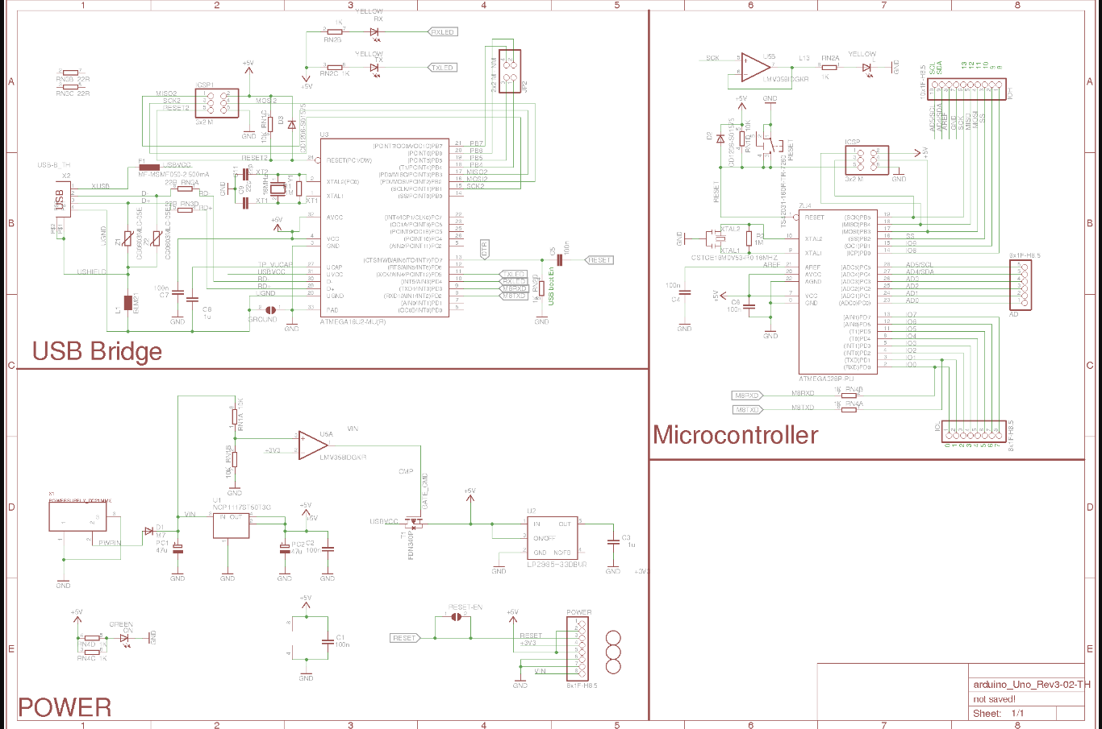
VLSI/ULSI Circuit Design

Slide 26
quizzes

Slide 27
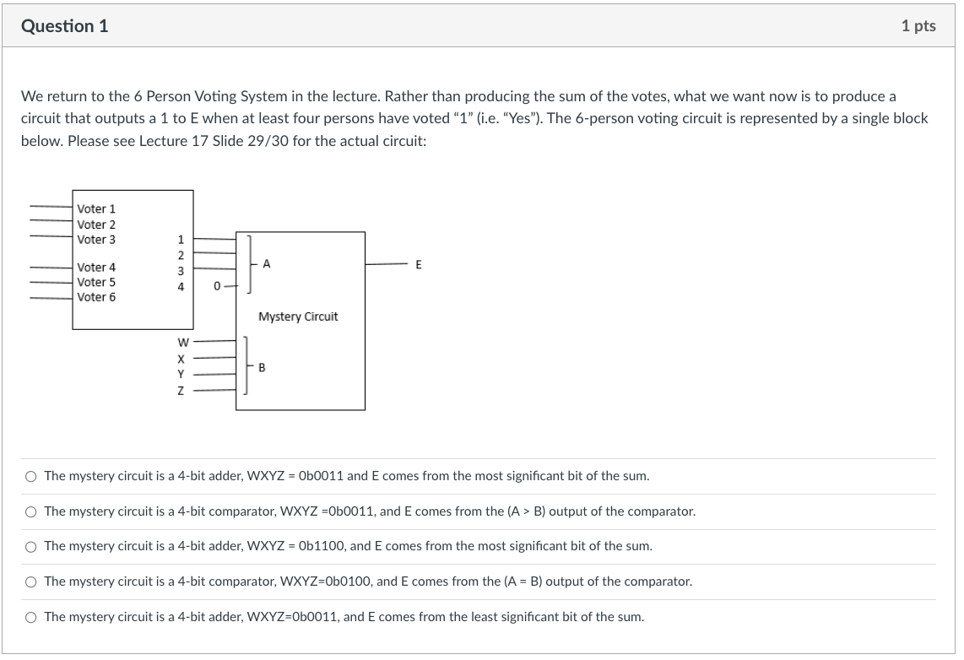
Lecture 17 Quiz 1 Question 1

Slide 28
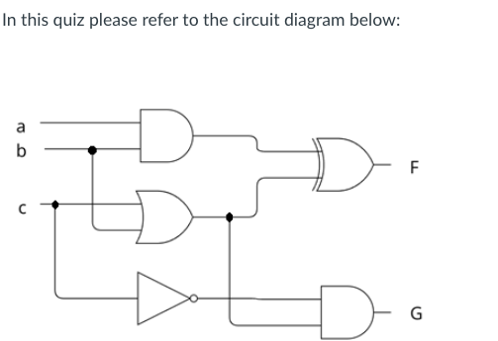
Lecture 17 Quiz 2

Slide 29
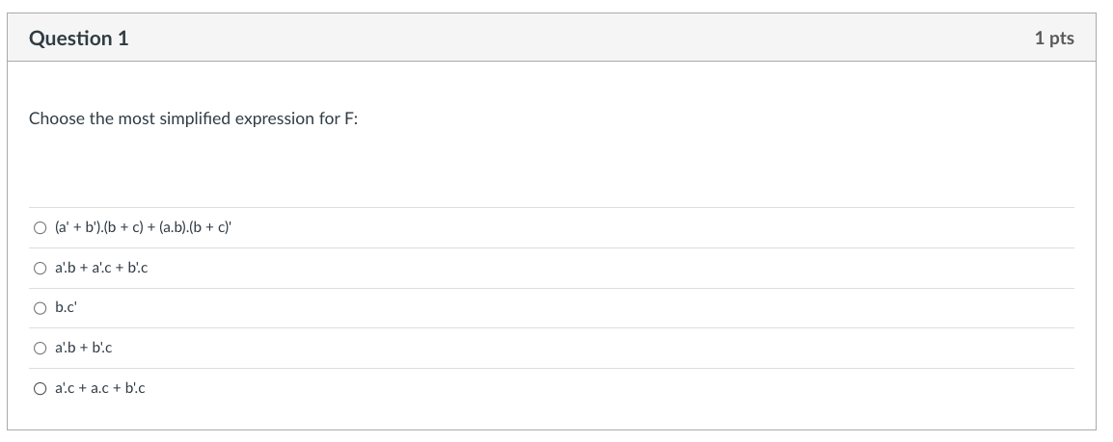
Lecture 17 Quiz 2 Question 1

Slide 30
Lecture 17 Quiz 2 Question 1
w = a.b
x = b + c
y = c’
F = w XOR x
= w’.x + w.x’
= (a.b)’.(b + c) + (a.b).(b + c)’
= (a’ + b’).(b + c) + (a.b).(b’.c’)
= a’.b + a’.c + b’.b + b’.c + a.b.b’.c’
= a’.b + a’.c + 0 + b’.c + 0
= a’.b + a’.c + b’.c
w
x
y

Slide 31
Lecture 17 Quiz 2 Question 1
Recall consensus theorem:
X.Y + X’.Z + Y.Z = X.Y + X’.Z
Compare with a’.b + a’.c + b’.c, or b.a’ + b’.c + a’.c.
We can set X=b, Y=a’, Z = c.
Immediately we can rewrite F as X.Y + X’.Z + Y.Z
Most simplified form of F therefore is X.Y + X’.Z = b.a’ + b’.c
= a’.b + b’.c

Slide 32
Lecture 17 Quiz 2 Question 1

Slide 33
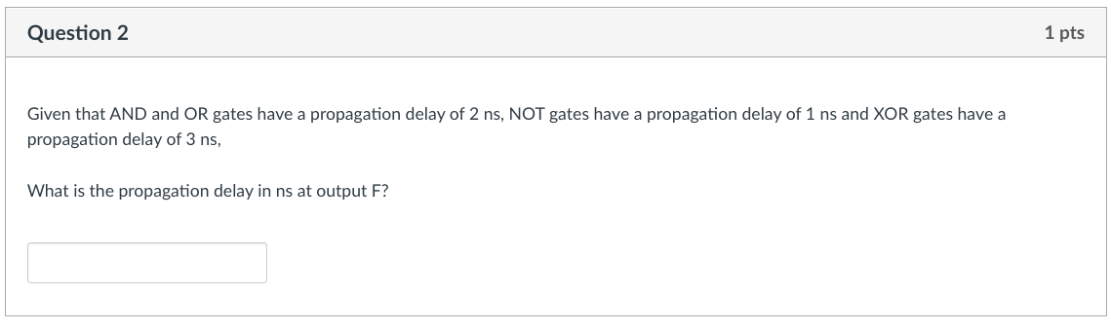
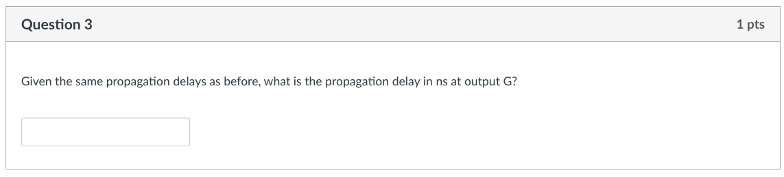
Lecture 17 Quiz 2 Question 2

Slide 34
Timing at w = Timing at x = max(0,0) + 2 = 2 ns
Timing at y = 0 + 1
= 1 ns
Timing at F = max(2, 2) + 3 = 5 ns
Timing at G = max(2, 1) + 2 = 4 ns
w
x
y

Slide 35
Lecture 17 Quiz 2 Question 2
5
4

Slide 36
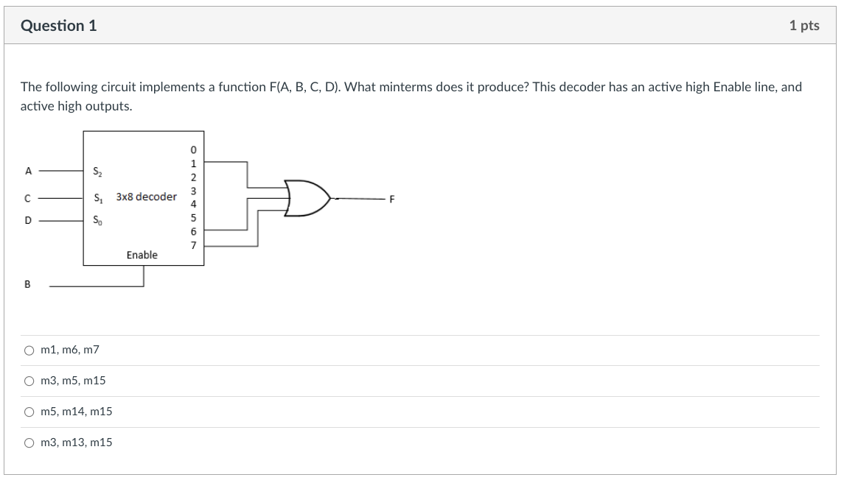
Lecture 18 Question 1

Slide 37
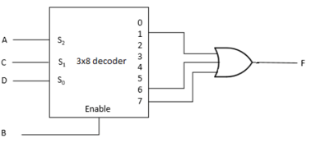
Lecture 18 Question 1
Observation:
Decoder is active only when b is 1. Hence all minterms must have b=1
Outputs:
1 is high when A=0, C=0, D = 1.
6 is high when A = 1, C = 1, D = 0
7 is high when A = 1, C = 1, D = 1
Hence minterms ABCD are:
0101 = m5
1110 = m14
1111 = m15

Slide 38
Lecture 18 Question 1

Slide 39
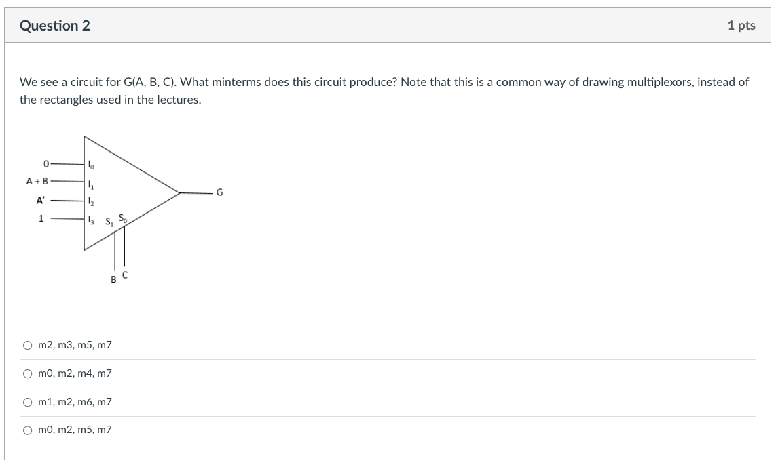
Lecture 18 Question 2

Slide 40
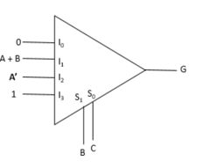
Lecture 18 Question 2
Observations:
No minterms when BC=0, since G=0
Minterms when BC=11, regardless of A.
Minterms when BC=01 and A is 1 or B is 1. But B cannot be 1!
Minterms when BC=10 and A = 0
Hence the minterms are:
011 and 111, m3 and m7
101, m5
010, m2
Minterms are m2, m3, m5, m7

Slide 41
Lecture 18 Question 2

Slide 42
Sli.do questions

Slide 43
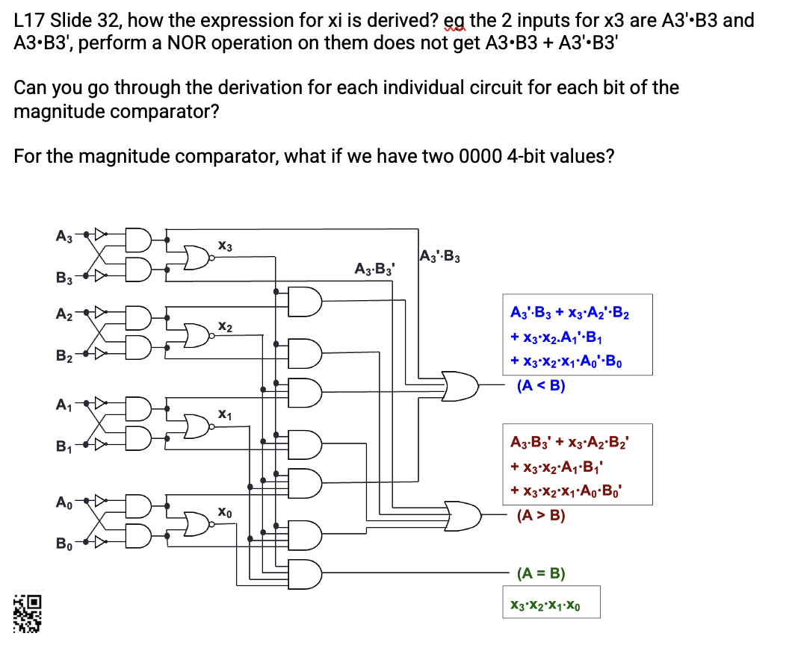
Slido Questions

Slide 44
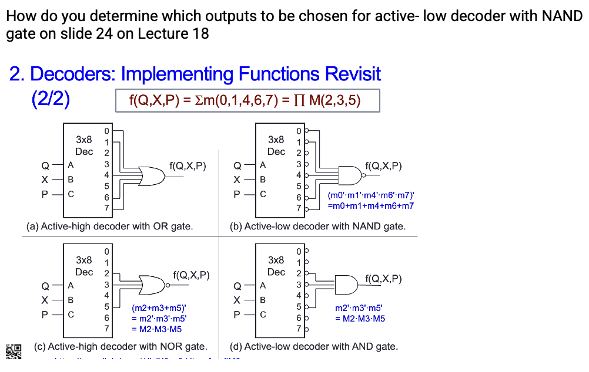
Slido Questions

Slide 45
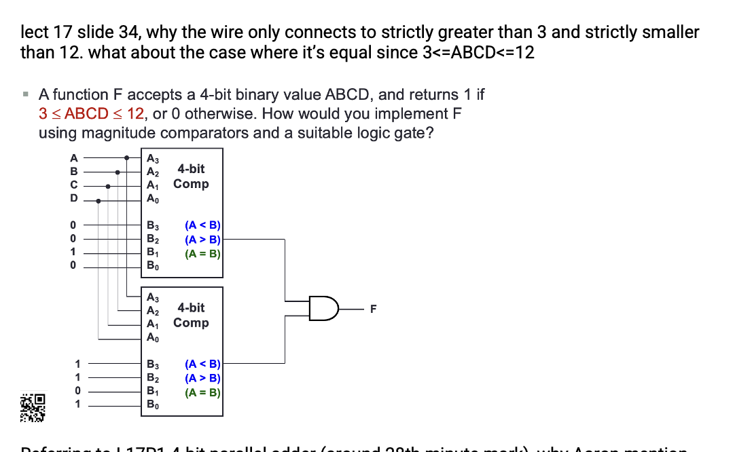
Slido Questions

Slide 46
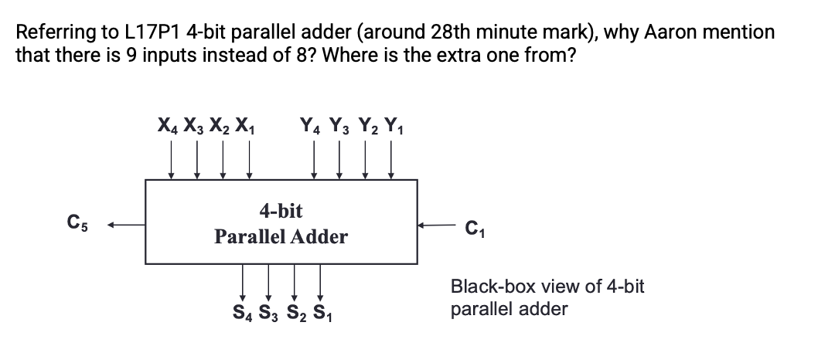
Slido Questions

Slide 47
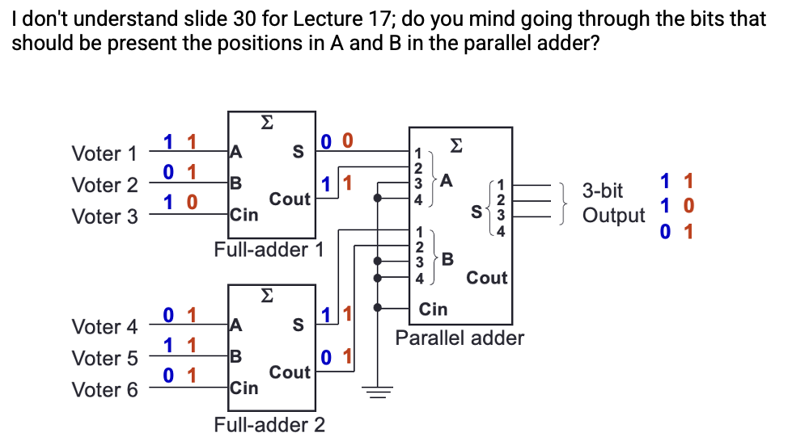
Slido Questions

Slide 48
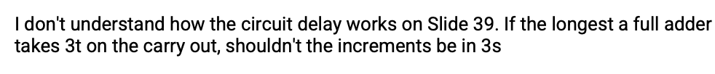
Slido Questions

Slide 49
9. Circuit Delays (1/5)
Given a logic gate with delay t. If inputs are stable at times t₁, t₂, …, t_{n}, then the earliest time in which the output will be stable is: max( t₁, t₂, …, t_{n} ) + t
t₁
t₂
Logic
Gate
:
:
max (t₁, t₂, ..., t_{n} ) + t
t_{n}
To calculate the delays of all outputs of a combinational circuit, repeat above rule for all gates.

Slide 50
9. Circuit Delays (2/5)
As a simple example, consider the full adder circuit where all inputs are available at time 0. Assume each gate has delay t.
X
Y
0
max(0,0)+t = t
max(t,0)+t = 2t
0
S
t
2t
max(t,2t)+t = 3t
C
Z
0
Outputs S and C experience delays of 2t and 3t respectively.

Slide 51
9. Circuit Delays (3/5)
More complex example: 4-bit parallel adder.
Y₄ X₄
Y₃ X₃
Y₂ X₂
Y₁ X₁
C₄
C₃
C₂
0
0
0
0
0
0
0
0
0
C₅
FA
FA
FA
FA
C₁
S₄
S₃
S₂
S₁

Slide 52
9. Circuit Delays (4/5)
Analyse the delay for the repeated block.
0
where X_{i}, Y_{i} are stable at 0t, while C_{i} is assumed to be stable at mt.
X_{i}
Y_{i}
C_{i}
S_{i}
C_{i+1}
0
Full
Adder
mt
Performing the delay calculation:
X_{i}
Y_{i}
0
max(0,0)+t = t
max(t,mt)+t
0
S_{i}
t
max(t,mt)+t
max(t,mt)+2t
C_{i+1}
C_{i}
mt

Slide 53
9. Circuit Delays (5/5)
max(t,mt)+t
X_{i}
Y_{i}
C_{i}
0
Full
Adder
S_{i}
C_{i+1}
0
mt
Calculating:
When i=1, m=0; S₁ = 2t and C₂ = 3t
When i=2, m=3; S₂ = 4t and C₃ = 5t
When i=3, m=5; S₃ = 6t and C₄ = 7t
When i=4, m=7; S₄ = 8t and C₅ = 9t
In general, an n-bit ripple-carry parallel adder will experience the following delay times:
S_{n} = ( (n – 1)2 + 2 ) t
C_{n+1} = ( (n – 1)2 + 3 ) t
Propagation delay of ripple-carry parallel adders is proportional to the number of bits it handles.
Maximum delay: ( (n – 1)2 + 3 ) t
max(t,mt)+2t

Slide 54
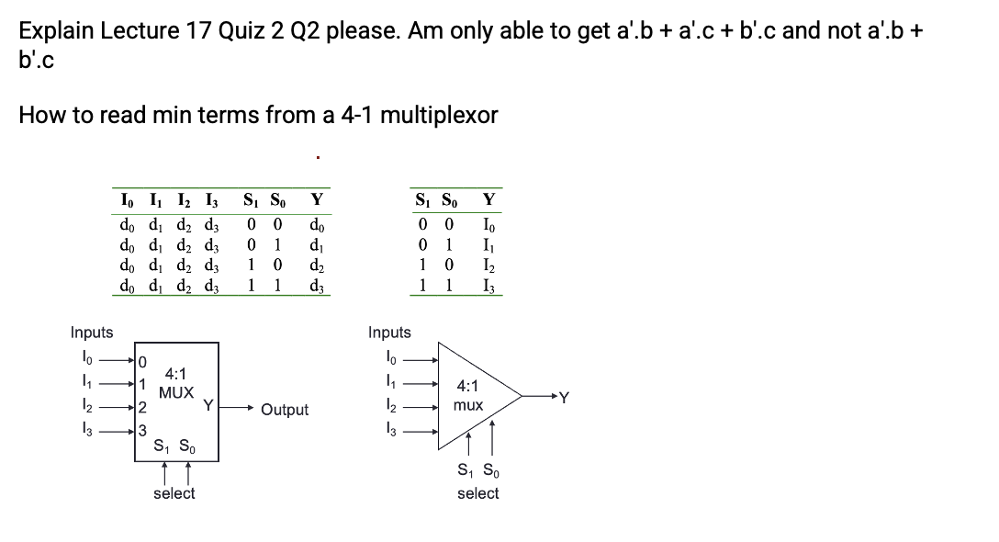
Slido Questions

Slide 55
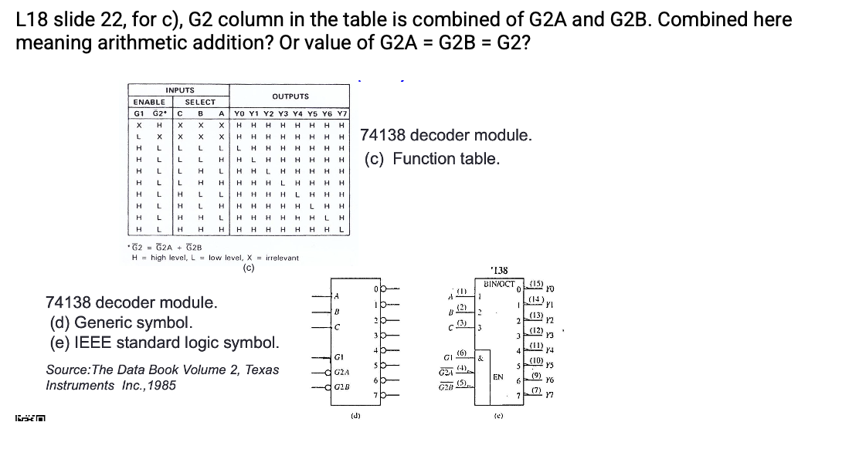
Slido Questions

Slide 56
End of File

